Slide 1

Natural Language Processing
Morphology and Finite-State Transducers
1

Slide 2
Morphology is the study of the way words are built from smaller units called morphemes
A morpheme is a minimal meaning-bearing unit in language.
Example: the word DOG has a single morpheme; the word CATS has two: (1) CATand (2) –S
There are two classes of morphemes: stems and affixes.
Stems -- are the main morphemes of words.
Affixes – add additional meaning to the stems to modify their meanings and grammatical functions
2

Slide 3
Morphology and Finite-State Transducers
There are four forms of affixes:
Prefixes – precede the stem
Suffixes – follow the stem
Infixes – inserted inside the stem
Circumfixes – both precede and follow the stem.
Examples:
Prefixes - “un”, “a”
Suffixes - plurals, “ing”
Infixes - not common in English
Circumfixes : unbelievably un + believe + able + ly
3

Slide 4
Kinds of Morphology
The usage of prefixes and suffixes concatenated to the stem creates a concatenative morphology.
When morphemes are combines in more complex ways, we have a non-concatenative morphology.
Inflectional morphology - is the combination of a word stem with a grammatical morpheme usually resulting in a word of the same class
Special case: Templatic morphology, also known as root-and-pattern morphology:
Used in semitic languages, e.g. Arabic, Hebrew
4

Slide 5
Example of Templatic Morphology
In Hebrew, a verb is constructed using two components: o A root (consisting usually of 3 consonants CCC) –
carrying the main meaning
o A template which gives the ordering of consonants and vowels and specifies more semantic information about the resulting verb, e,g, the voice (active, passive)
o Example: the tri-consonant root lmd (meaning: learn, study)
can be combined with a template CaCaC for active voice to produce the word lamad = “he studied”
can be combined with the template CiCeC for intensive to produce the word limed = “he tought”
can be combined with a template CuCaC for active voice to produce the word lumad = “he was taught”
5

Slide 6
Producing words from morphemes
By inflection – Inflectional morphology - is the combination of a word stem with a grammatical morpheme usually resulting in a word of the same class
By derivation – Derivational Morphology - is the combination of a word stem with a grammatical morpheme usually resulting in a word of a different class.
By compounding – by combining multiple words together, e.g. “doghouse”
By cliticization – by combining a word stem with a clitic. A clitic is a morpheme that acts syntactically like a word but it is reduced in forms and it is attached to another word. Eg.g I’ve.
6

Slide 7
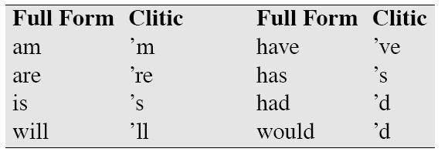
Clitization
A clitic is a unit whose status lies between that of an affix and a word!
The phonological behavior of clitics is like affixes: they then to be short and unaccented
The syntactic behavior is more like words: they often act as pronouns, articles, conjunctions or verbs.
7

Slide 8
Inflectional Morphology 1/2
Nouns: have an affix for plural and an affix for possessive
Plural – the suffix –s and the alternative spelling –es for regular nouns
Singular | Plural
dog | dogs
farm | farms
school | schools
car | cars
Singular | Plural
ibis | ibises
waltz | waltzes
box | boxes
butterfly | butterflies
Irregular nouns:
Possessive - for words not ending in “s” the affix is “’s” (children/
children’s ) and for words ending in “s” the affix is “’” (llama/llama’s; llamas/llamas’) (Euripides/Euripides’ comedies )
Singular | Plural
mouse | mice
ox | oxen
8

Slide 9
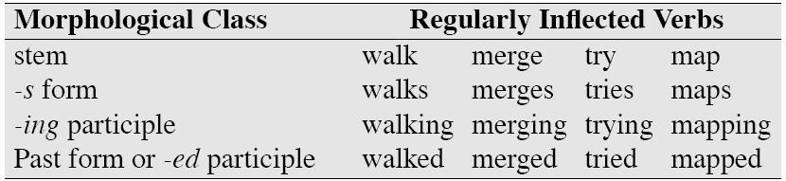
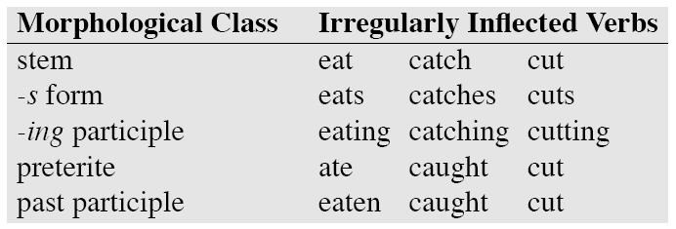
Inflectional Morphology 2/2
Verbal inflection is more complex than nominal inflection
There are three classes of verbs in English:
Main verbs (eat, sleep, walk)
Modal verbs (can ,will, should)
Primary verbs (be, have, do)
Regular/ Irregular Verbs
9

Slide 10
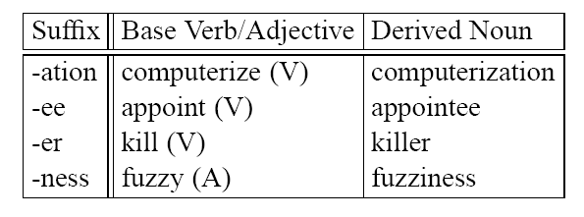
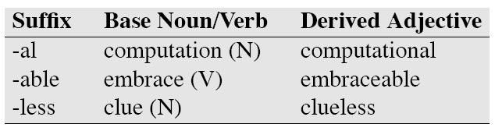
Derivational Morphology
Changes of word class
Nominalization: the formation of new nouns from verbs or adjectives.
Adjectives can also be derived from verbs.

Slide 11
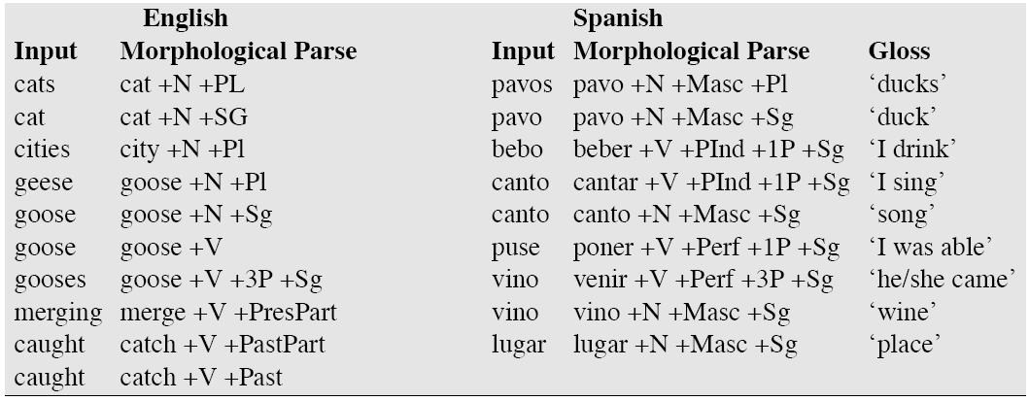
Morphological Parsing
In general parsing means taking an input and producing a structure for it.
Morphological parsing takes as an input words and produces a structure that reveals its morphological features.

Slide 12
Building a Morphological Parser
We need:
Lexicon - is the list of stems and affixes and basic information about them
Morphotactics – the model of morpheme ordering that expains which classes of morphemes can follow other classes of morphemes inside a word.
Ortographic rules - or spelling rules model the changes that occur in a word when morphemes are combined.

Slide 13
Morpholgy and FSAs
We’d like to use the machinery provided by FSAs to capture these facts about morphology
Accept strings that are in the language
Reject strings that are not
And do so in a way that doesn’t require us to in effect list all the words in the language
9/11/2011
Speech and

Slide 14
Start Simple
Regular singular nouns are ok
Regular plural nouns have an -s on the end
Irregulars are ok as is
9/11/2011
Speech and

Slide 15
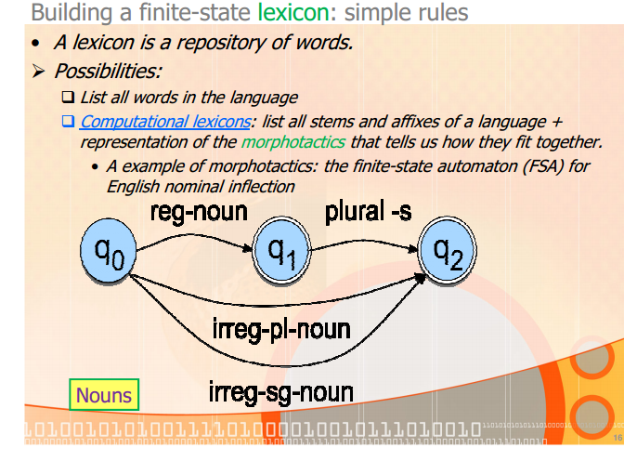

Slide 16
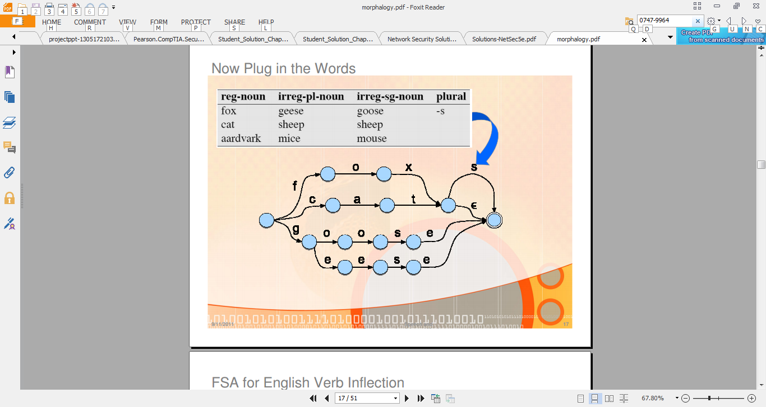
9/11/2011
17

Slide 17
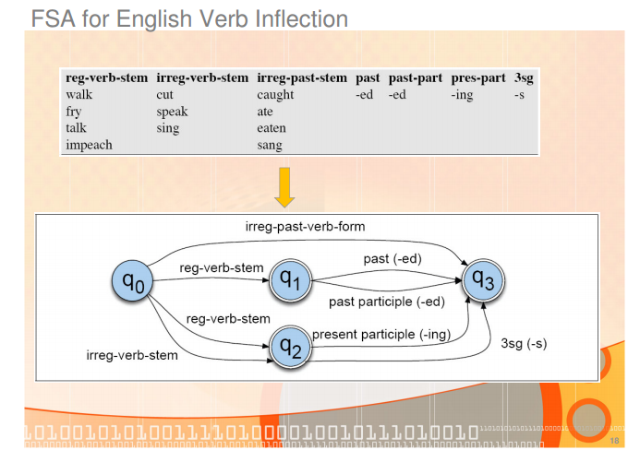

Slide 18

Models for derivational morphology
More complex than inflectional morphology. FSA tend to be more complex.
Simple case: morphotactics of English adjectives
Examples from Antworth (1990)
big, bigger, biggest | cool, cooler, coolest, coolly
happy, happier, happiest, happily | red, redder, reddest
unhappy, unhappier, unhappiest, unhappily | real, unreal, really
clear, clearer, clearest, clearly, unclear, unclearly
While this will recognize most of the adjectives, it will also recognize ungrammatical forms like: unbig, redly, realest.

Slide 19
Parsing/Generation vs. Recognition
We can now run strings through these machines to recognize strings in the language
But recognition is usually not quite what we need
Often if we find some string in the language we might like to assign a structure to it (parsing)
Or we might have some structure and we want to produce a surface form for it (production/generation)
Example
From “cats” to “cat +N +PL”
9/11/2011
Speech and
21

Slide 20

Finite-State Transducers
A transducer maps between one representation and another.
A finite-state transducer (FST) is a type of finite automaton which maps between two sets of symbols.
An FST is a two-tape automaton which recognizes or generates pairs of strings. Thus we can label each arc in the finite-state machine with two symbols, one for each tape.
22

Slide 21
Finite State Transducers
The simple story
Add another tape
Add extra symbols to the transitions
On one tape we read “cats”, on the other we write “cat +N
+PL”
9/11/2011
Speech and
23

Slide 22
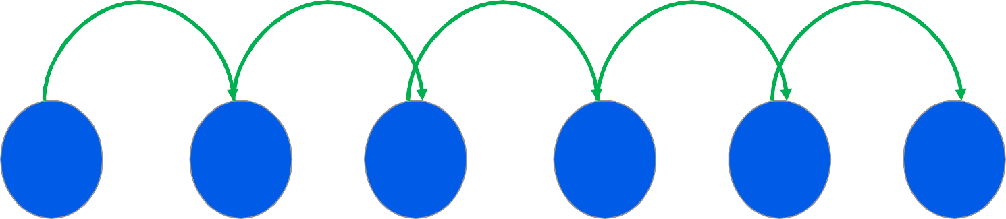
Transitions
c:c
a:a
t:t
+N: ε
+PL:s
c:c means read a c on one tape and write a c on the other
• +N:ε means read a +N symbol on one tape and write nothing on the other
• +PL:s means read +PL and write an s
9/11/2011
Speech and Language Processing - Jurafsky and Martin
24

Slide 23
Typical Uses
Typically, we’ll read from one tape using the first symbol on the machine transitions (just as in a simple FSA).
And we’ll write to the second tape using the other symbols on the transitions.
9/11/2011
Speech and

Slide 24
Ambiguity
Recall that in non-deterministic recognition multiple paths through a machine may lead to an accept state.
Didn’t matter which path was actually traversed
In FSTs the path to an accept state does matter since different paths represent different parses and different outputs will result
9/11/2011
Speech and

Slide 25
FSTs and FSAs
FSTs have a more general function than FSAs:
An FSA defines a formal language by defining a set of strings
An FST defines a relation between sets of strings
Another view: an FST is a machine that reads one string and generates another one.

Slide 26
A four-fold way of thinking
FST as recognizer: a transducer that takes a pair of strings as input and outputs accept if the string pair is in the string-pair language, and reject if it is not.
FST as generator: a machine that outputs pairs of strings of the language. The output is a yes or a no, and a pair of output strings.
FST as translator: a machine that reads a string and outputs another string
FST as set relater: a machine that computes relations between sets.
Parsing is done with the FST.
A transducer maps one set of symbols into another. An FST uses a finite automata.
Two level morphology : for each word is the correspondence between lexical level and surface level.

Slide 27
Formal definition of an FST
Defined by 7 parameters:
Q: a finite state of N states q₀, q₁, … , q_{n}
Σ: a finite set corresponding to the input alphabet
∆: a finite set corresponding to the output alphabet
q_{o}∈Q: the start state
F⊆ Q: the set of final states
δ(q,w) : the transition function (or transition matrix between states)
σ(q,w): the output function, giving the set of all possible output strings for each state and input.

Slide 28
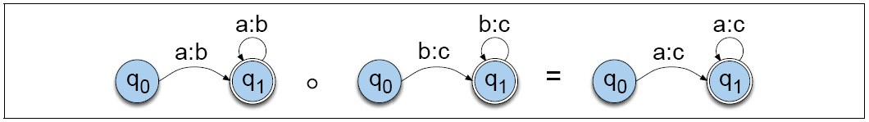
Regular Relations
Remember: FSAs are isomorphic to regular languages.
FSTs are isomorphic to regular relations.
Definition: Regular relations are sets of pairs of strings!!! (extension to regular languages, which are sets of strings)
Operations:
Inversion: the inversion of a Transducer T (T⁻¹) switches the input with the output labels
Composition: If T₁ is a transducer from I₁ to O₁ and T₂ is a transducer from O₁ to O₂ then T₁ oT₂ is a transducer from I₁ to O₂

Slide 29
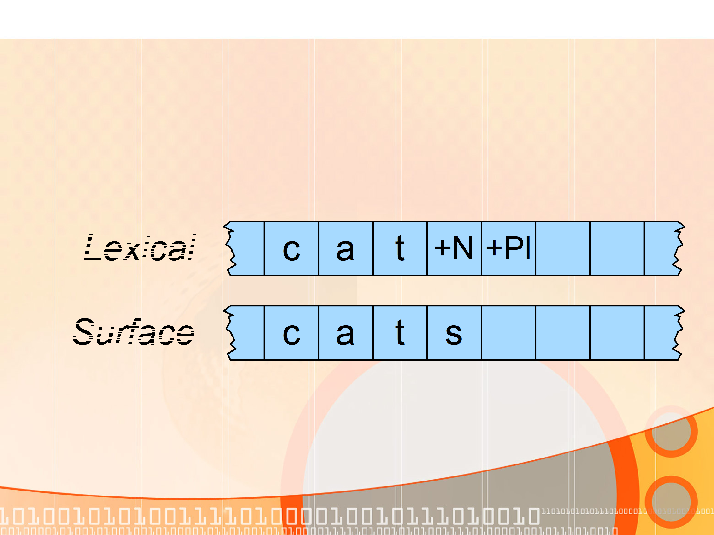
FSTs for Morphological Parsing
9/11/2011
Speech and

Slide 30
Applications
The kind of parsing we’re talking about is normally called morphological analysis
It can either be
An important stand-alone component of many applications (spelling correction, information retrieval)
Or simply a link in a chain of further linguistic analysis
9/11/2011
Speech and

Slide 31

Morphological Parsing with Finite-State Transducers
In finite-state morphology, we represent a word as a correspondence between a lexical level (concatenations of morphemes) and a surface level (concatenation of letters which make up the spelling of the word).
For finite-state morphology, it is convenient to view an FSt as having two tapes. The lexical tape is composed from characters from one alphabet Σ. The surface tape is composed from characters from another alphabet ∆.
The two alphabets can be combined in a new alphabet of complex symbols
Σ’. Each complex symbol is composed of an input-output pair: (i,o) with i∈ Σ and o ∈ ∆, thus Σ’⊆ Σ × ∆. Note, Σ and ∆ may include the
epsilon symbol ε

Slide 32
Feasible pairs
The pairs of symbols from Σ’ are called feasible pairs.
Meaning: each feasible pair symbol a:b from Σ’ expresses how the symbol a from one tape is mapped in the symbol b on the other tape.
Example: a:ε means that a on the upper tape will correspond to nothing on the lower tape.
Pairs a:a are called default pairs and we refer to them by the single letter a.
An FST mophological parser can be built from a morphotactic FSA by adding an extr “lexical” tape and the appropriate morphological features.
How??

Slide 33

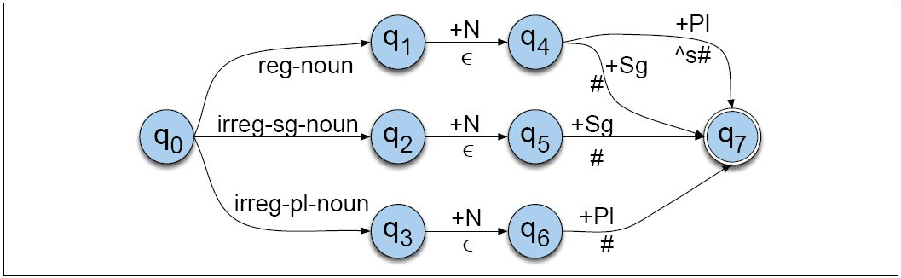
How??
Use nominal morphological features (+Sg and +Pl) to augment the FSA for nominal inflection:
The symbol ^ indicates morpheme boundary The symbol # indicates word boundary

Slide 34
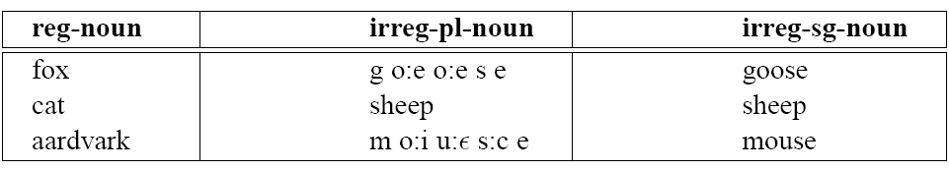
Expanding FSTs with lexicons
Update the lexicon such that irregular plurals such as geese will parse into the correct stem: goose +N +Pl
The lexicon can have also two levels
Example: “g:g o:e o:e s:s e:e” or “g o:e o:e s e”
The lexicon will be more complex:

Slide 35
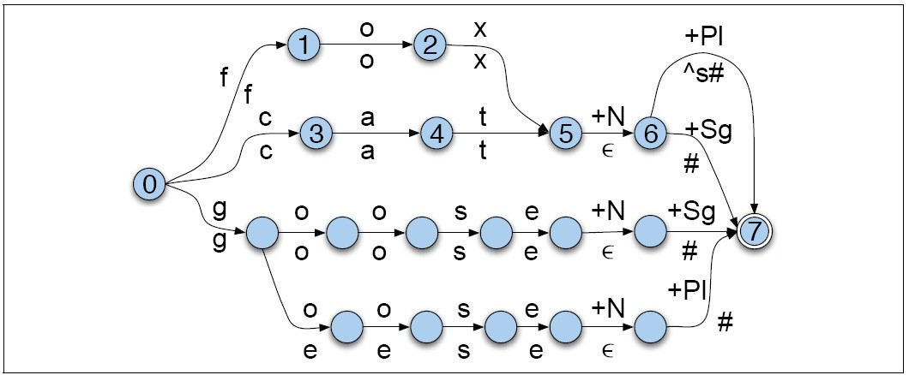
Expanding a nominal inflection FST
^{T}num
^{T}lex

Slide 36

Intermediary Tapes

Slide 37
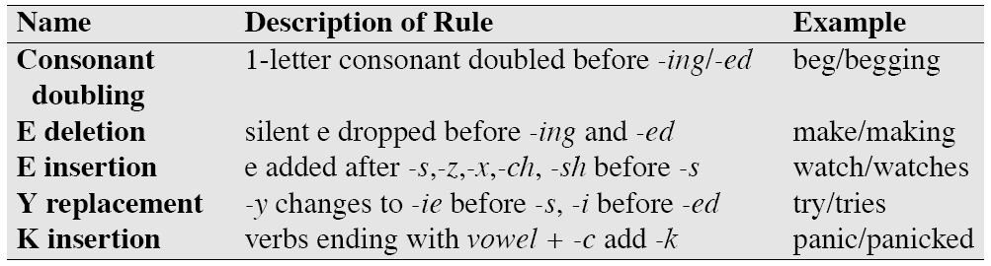
Transducers and Orthographic Rules
Problem: English often requires spelling changes at morpheme boundaries
Solution: introduce spelling rules (orthographic rules)
How to handle context-specific spelling rules. cat + N + PL -> cats (this is OK)
fox + N + PL -> foxs (this is not OK)

Slide 38
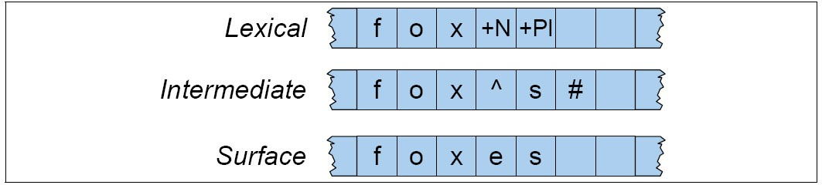
Example of lexical, intermediate and surface tapes.
Between each tape there is a two-level transducer!
FST between the
lexical and intermediate levels
The E-insertion rule between the intermediate Land the surface level

Slide 39
E-insertion rule
How do we formalize it?

Slide 40
Chomsky and Halle’s Notation
ε -> e / {x, s, z} ^ s#
Insert e on the surface tape when the lexical tape has a morpheme ending in x, s or z and the next morpheme is –s.
The E-insertion rule

Slide 41
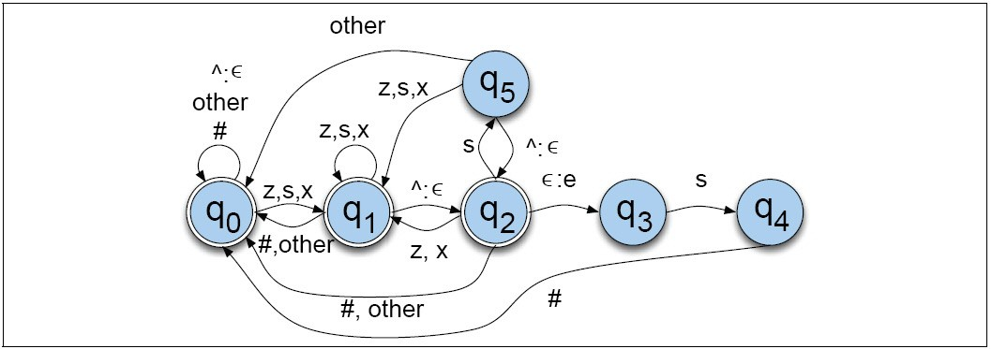
Q_{o} models having seen only default pairs, unrelated to the rule Q₁ models having seen z,s or x
Q₂ models having seen the morpheme boundary after the z,s,x
Q₃ models having just seen the E-insertion – not an accepting state Q₅ is there to insure that e is always inserted when needed

Slide 42
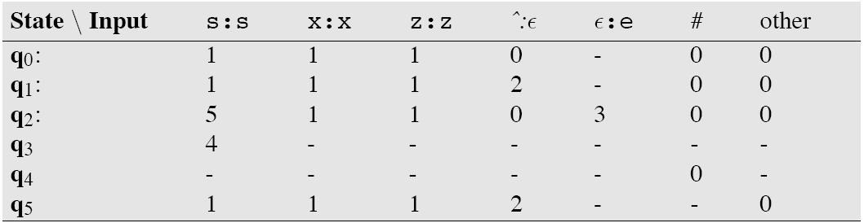

Slide 43
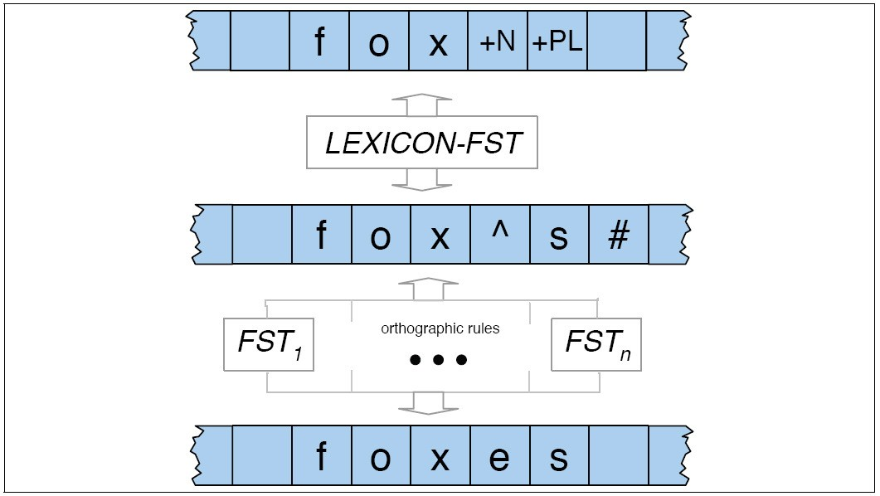
Combining FST Lexicon and Rules

Slide 44
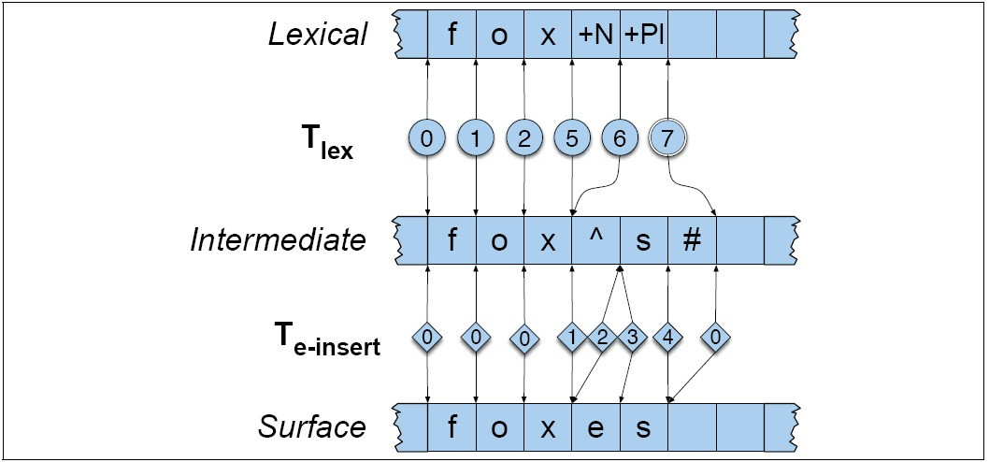

Slide 45
Some difficulties
Generating the surface tape from the lexical tape.
Parsing has to deal with ambiguity
Disambiguation requires some external evidence:
Example: “I saw two foxes yesterday” Fox is a noun !
“That trickster foxes me everytime!” Fox is a verb!

